Slide 1

Price Sense AI
Theme - SDG 8, 9, 12
Category - Software
Group No - 14
Group Members - Ritesh J., Sahil B., Shreesh N.
Guide- Dr. Bharti Khemani

Slide 2
Outline
Introduction
Literature Survey of the existing systems
Limitations of the existing systems
Problem statement and Objective
Sustainable Development Goals
Proposed System
Experimental Setup(Details about input/ dataset, Performance evaluation parameters, Software and hardware setup)
Implementation(Screenshots of all modules)
Conclusion and future work
References
Research Paper Publication / Patent/ Copyright status

Slide 3
Introduction
Online shopping platforms frequently change product prices.
Users often miss the best time to purchase products at lower prices.
Existing e-commerce platforms do not provide price history transparency.
Manual price tracking is time-consuming and inefficient.
There is a need for an automated system to track price changes and notify users.

Slide 4
Introduction
Objectives:
To design a smart system for tracking product prices.
To provide historical price analysis using visual charts.
To notify users automatically on price drops.
To support multiple e-commerce platforms.
To ensure secure and personalized user experience.

Slide 5
Literature Survey of the existing system
Year | Author | Title | Technologies | Description
2023 | Divya Khairkar et al. | E-Commerce Product Price Tracker Using Dynamic Pricing Algorithm | Web Scraping, Dynamic Pricing Algorithm, Alerts | This study proposes a dynamic pricing-based price tracker that extracts pricing information from multiple e-commerce sites and notifies users on price drops. It includes historical price data tracking and dynamic pricing analysis, though scalability and handling of JavaScript-based sites remain limited.
2024 | Abhishek K S et al. | Insight Cart - A Product Analysis Website Using Web Scraping and Machine Learning | Selenium, BeautifulSoup, ML Algorithms | The work combines web scraping from several platforms with machine learning for product ranking and price trend prediction. It offers visual price analytics, yet it lacks real-time alerting and secure personalized tracking functionality to support individual user needs fully

Slide 6
Literature Survey of the existing system
Year | Author | Title | Tech | Description
2024 | A. A. Patel et al. | Dynamic Price Monitoring in E-Commerce | Web Scraping, Data Analysis, Email Automation | This research presents a real-time price monitoring system that automates data extraction and provides visual price trend analysis with email alerts. Although it advances automation, it faces challenges with handling dynamic content and anti-bot detection on modern e-commerce platforms.
2024 | Fan Chen | Research on Real-Time E-Commerce Price Comparison System Using Python Web Scraping Technology | Python, BeautifulSoup, Scrapy, Selenium | This study explores real-time price comparison across e-commerce platforms using Python scraping libraries, evaluating different tools for handling static and dynamic content. It provides insights into efficient scraper selection, though it does not include end-user alerting or personalized tracking components.

Slide 7
Literature Survey of the existing system
Year | Author | Title | Tech | Description
2024 | Nitya Sharma & Nishant Agnihotri | Web Scraping Application | Web Scraping APIs, Automation, Scheduled Jobs | This paper proposes a web scraping based tracking system that extracts product price data from e-commerce sites and uses automation with scheduled jobs for periodic price updates. The work includes price history visualization and email alert integration, but it is limited in handling multi-platform dynamic content and lacks scalable user authentication.
2024 | Arman Shaikh et al. | E-commerce Price Comparison Website Using Web Scraping | Web Scraping, Database Systems, Price Comparison | The system focuses on comparing product prices across different e-commerce platforms by extracting price data using web scraping. It supports consumer decision-making through comparative visibility but does not include automated historical tracking or real-time user notifications on price changes.

Slide 8
Limitations of Existing Systems
Survey Analysis
Manual tracking of prices is inefficient.
Static scrapers fail on JavaScript-heavy websites.
No automated notifications for users.
Limited support for multiple platforms.
Poor data security and user personalization.

Slide 9
Limitations of Existing Systems
Problem Gaps
Existing price tracking systems are mostly manual or platform-specific.
Basic scraping techniques fail on dynamic, JavaScript-based websites.
Automated price monitoring and alerts are not reliably implemented.
Historical price analysis is limited or unavailable.
Lack of secure and scalable user-specific tracking solutions.
Our Contribution
DealDrop is an automated price tracking system that monitors products across multiple e-commerce platforms, stores price history, and notifies users of price drops, enabling informed purchasing decisions.

Slide 10
Problem statement
Online product prices change frequently across e-commerce platforms, making it difficult for users to identify the right time to purchase. Existing tools lack reliable multi-platform tracking, automated price monitoring, and timely price drop alerts, resulting in missed savings opportunities.

Slide 11
Sustainable Development Goals
SDG 12 – Responsible Consumption and Production
Helps users make informed purchasing decisions.
Reduces unnecessary spending.
SDG 9 – Industry, Innovation and Infrastructure
Uses modern AI-based web scraping.
Implements scalable cloud architecture.
SDG 8 – Decent Work and Economic Growth
Uses modern AI-based web scraping.
Implements scalable cloud architecture.

Slide 12
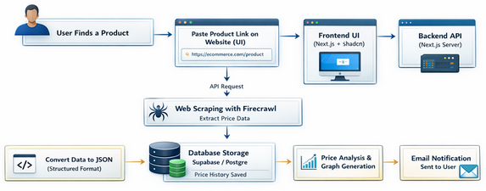
System Design
Fig 1. System Diagram

Slide 13
Technologies and methodologies
Frontend | Next.js, React, Tailwind CSS
Backend: | Supabase, PostgreSQL
Scraping: | Firecrawl API
Authentication | Google OAuth
Email Service: | Resend
Scheduling:
pg_cron

Slide 14
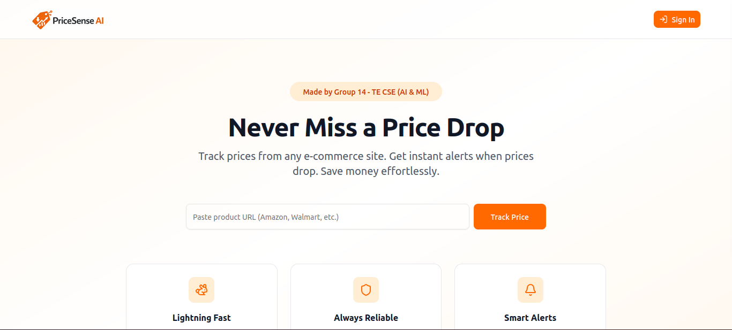
Implementation
Fig 1. Landing Page

Slide 15
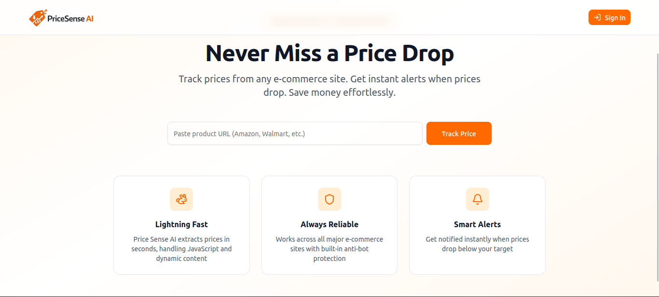
Implementation
Fig 2. Home Page

Slide 16
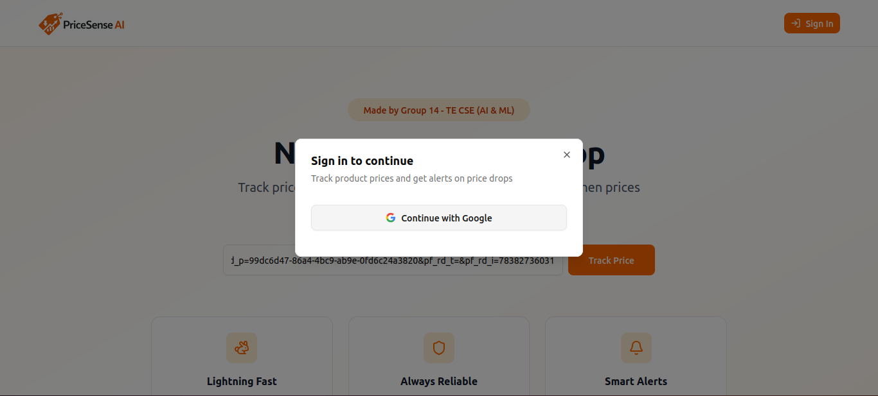
Implementation
Fig 3. Sign In Page

Slide 17
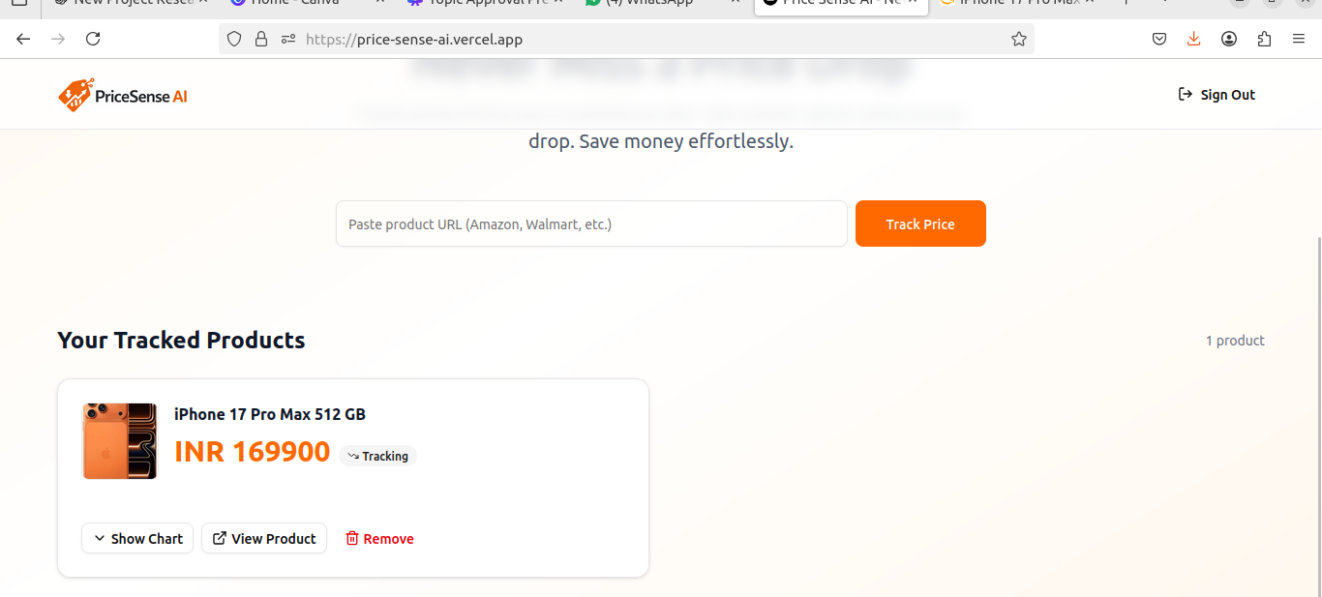
Implementation
Fig 4. Price Tracking based on Product Link

Slide 18
References
1] D. Khairkar, S. Dambhare, O. Gupta, V. Thakre, N. Raut, and S. N. Dagadkar, “E‑Commerce Product Price Tracker using Dynamic Pricing Algorithm,” International Journal for Research in Applied Science & Engineering Technology (IJRASET), vol. 11, no. V, May 2023, pp. –, doi: 10.22214/ijraset.2023.51478.
[2] A. K. S. Abhishek, S. Ravindra, B. H. Archana, H. J. Abhishek, and S. Palankar, “Insight Cart‑ A Product Analysis Website Using Web Scraping and Machine Learning,” International Journal for Research in Applied Science & Engineering Technology (IJRASET), vol. 12, no. XII, Dec. 2024, pp. –, doi: 10.22214/ijraset.2024.65845.
[3] N. Sharma and N. Agnihotri, “Web Scraping Application,” International Journal for Research in Applied Science & Engineering Technology (IJRASET), vol. 12, no. III, Mar. 2024, pp. –, doi: 10.22214/ijraset.2024.59194.
[4] A. A. Patel, A. R. Bhandare, A. S. Chauhan, S. V. Ghume, and T. V. Rajarshi, “Dynamic Price Monitoring in E‑Commerce: Leveraging Web Scraping, Data Analysis, and Email Automation for Dynamic Pricing Insights,” International Journal for Research in Applied Science & Engineering Technology (IJRASET), vol. 12, no. X, Oct. 2024, pp. –, doi: 10.22214/ijraset.2024.64786.

Slide 19
References
[5] “Research on Real‑Time E‑Commerce Price Comparison System Using Python Web Scraping Technology,” ResearchGate, 2023.
[6] “E‑commerce Price Comparison Website Using Web Scraping,” ResearchGate, 2023.

Slide 20
Thank You...!!

